Slide 1
Manipulating Pictures, Arrays, and Loops part 6
Barb Ericson
Georgia Institute of Technology
August 2005

Slide 2
Learning Goals
Understand at a conceptual and practical level
  How to change all the colors in a method
  How to use a for loop
  How to negate a picture
  How to turn a picture into grayscale
  How to adjust the grayscale based on how we perceive colors

Slide 3
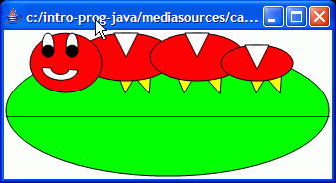
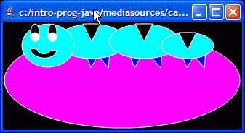
Negating an Image
How would you turn a picture into a negative?
  White should become black
    255,255,255 becomes 0,0,0
  Black should become white
    0,0,0 becomes 255,255,255

Slide 4
Negate Algorithm
Subtract current value from 255 for red, green, and blue
  Get the array of pixels from the picture
  Declare variables to hold the current pixel and the red, green, and blue values
  Loop starting an index at 0 and incrementing by 1 and loop while the index is less than the length of the array
    Get the pixel at the current index from the array of pixels
    Set the red value to 255 – current red value
    Set the blue value to 255 – current blue value
    Set the green value to 255 – current green value
    Increment the index and go back to step 3

Slide 5
Negate Method
/**
* Method to negate the picture
*/
public void negate()
{
Pixel[] pixelArray = this.getPixels();
Pixel pixelObj = null;
int redValue, blueValue, greenValue = 0;
// loop through all the pixels
for (int i = 0; i < pixelArray.length; i++)
{
// get the current pixel
pixelObj = pixelArray[i];
// get the values
redValue = pixelObj.getRed();
greenValue =
pixelObj.getGreen();
blueValue = pixelObj.getBlue();
// set the pixel's color pixelObj.setColor(
new Color(255 - redValue,
255 - greenValue,
255 - blueValue));
}
}

Slide 6
Changing to Grayscale
Grayscale ranges from black to white
  The red, green, and blue values are the same
How can we change any color to gray?
  What number can we use for all three values?
    The intensity of the color
  We can average the colors
    (red + green + blue) / 3
  Example
    (15 + 25 + 230) / 3 = 90
Notes:
To average x numbers get the sum of all the numbers and then divide by x.

Slide 7
Grayscale Algorithm
Set color values to the average of the original values
  Get the array of pixels from the picture
  Declare variables to hold the current pixel and the red, green, and blue values
  Loop starting an index at 0 and incrementing by 1 and loop while the index is less than the length of the array
    Get the pixel at the current index from the array of pixels
    Calculate the average of the current values
      (redValue + greenValue + blueValue )/ 3
    Set the red value to the average
    Set the blue value to the average
    Set the green value to the average
    Increment the index and go to step 3

Slide 8
Grayscale Method
/**
* Method to change the picture to gray scale
*/
public void grayscale()
{
Pixel[] pixelArray = this.getPixels();
Pixel pixelObj = null;
int intensity = 0;
// loop through all the pixels
for (int i = 0; i < pixelArray.length; i++)
{
// get the current pixel
pixelObj = pixelArray[i];
// compute the average intensity
intensity =
(pixelObj.getRed() +
pixelObj.getGreen() +
pixelObj.getBlue()) / 3;
// set the pixel color
pixelObj.setColor(new Color(intensity,intensity,intensity));
}
}

Slide 9
Testing Grayscale
String file =
“c:/intro-prog-java/mediasources/caterpillar.jpg”;
Picture pictureObj = new Picture(file);
pictureObj.explore();
pictureObj.grayscale();
pictureObj.explore();

Slide 10
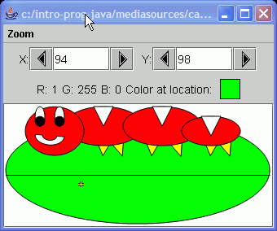
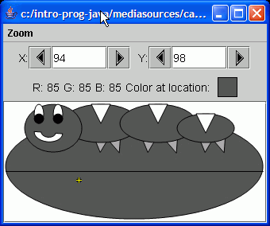
Grayscale Result

Slide 11
Luminance
We perceive blue to be darker than red, and green
  Even when the same amount of light is reflected
A better grayscale model should take this into account
  Weight green the highest (* 0.587)
  red less (* 0.299) and
  blue the very least (* 0.114)

Slide 12
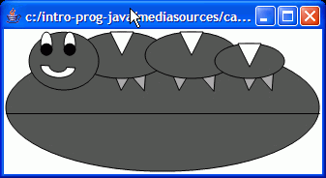
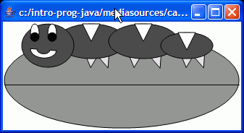
Grayscale with Luminance Exercise
Create a new method grayscaleWithLuminance
Using the new algorithm for calculating intensity
intensity = (int) (red * 0.299 + green * 0.587 + blue * 0.114)

Slide 13
Testing Grayscale with Luminance
String file =
“c:/intro-prog-java/mediasources/caterpillar.jpg”;
Picture pictureObj = new Picture(file);
pictureObj.explore();
pictureObj.grayscaleWithLuminance();
pictureObj.explore();

Slide 14
Summary
You can change all the colors in a method
  By creating a new color object
You can negate a picture
  By creating a new color with (255 - red, 255 - green, 255 - blue)
You can create a grayscale picture
  By setting the red, green, and blue to the same value
  You can improve this by weighting the colors based on how we perceive them

